Slide 1

Group9.getEvent()
AN EVENT REPOSITORY
Namrata Singh
Naveenraj Palanisamy
Navya Vandanapu
Niveditha Varadha Chandrasekaran
Shravya Kuncha

Slide 2
PROJECT SCOPE FOR ITERATION 3
VISION
To create a web application – EventIt!,
A one stop event repository that helps people to know about the various events happening in and around their neighborhood.
Which serves as a platform for the event hosts to promote their ticket free events.
Rating the past registered events and associating the rating to the host.
Updating the event details by the host.
Deleting the event by the host.
Register to the application.
Login into the application.
Email Notifications to the user.
Backlogs from Iteration 2.

Slide 3
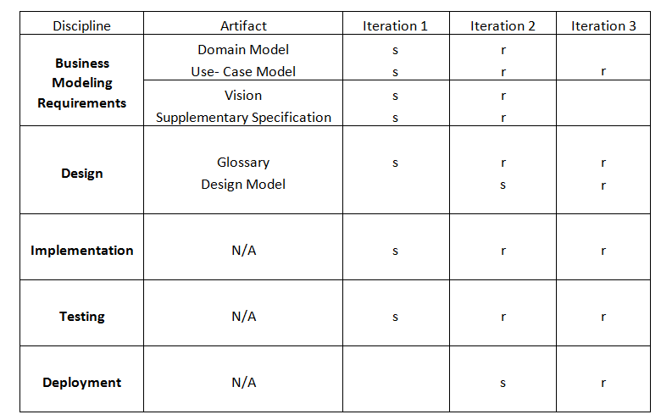
DEVELOPMENT CASE

Slide 4
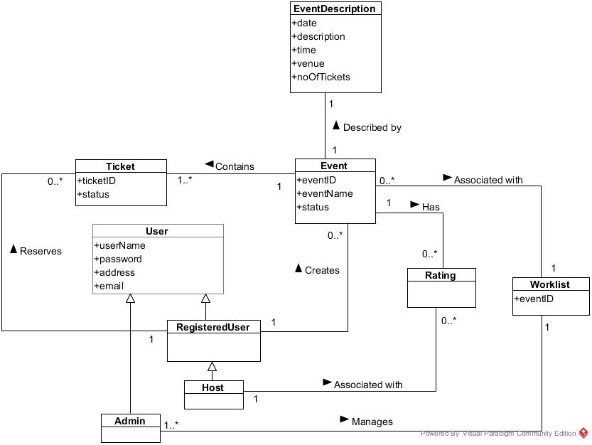
Domain Model

Slide 5
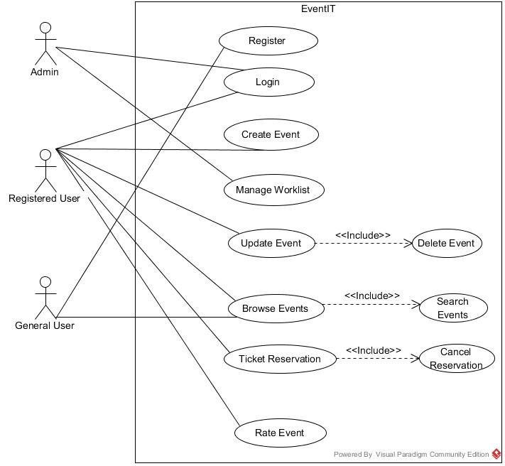
USE CASE DIAGRAM

Slide 6
USE CASES- ITERATION 3
LOGIN
REGISTER
UPDATE EVENT
DELETE EVENT
RATE EVENT

Slide 7
USE CASE TEXT

Slide 8
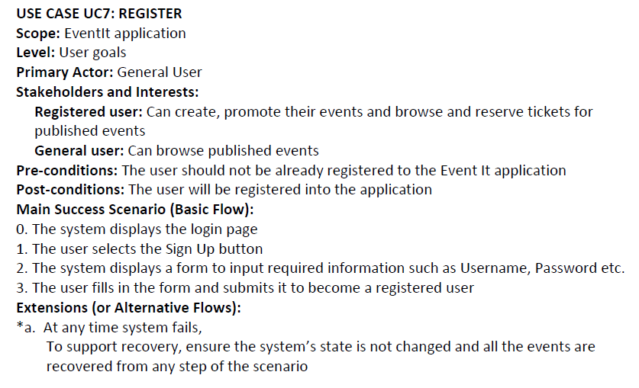
USE CASE UC7: REGISTER

Slide 9
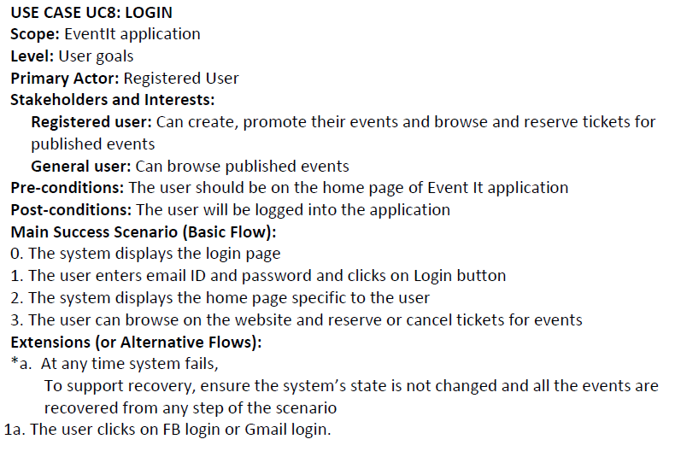
USE CASE UC8: LOGIN

Slide 10
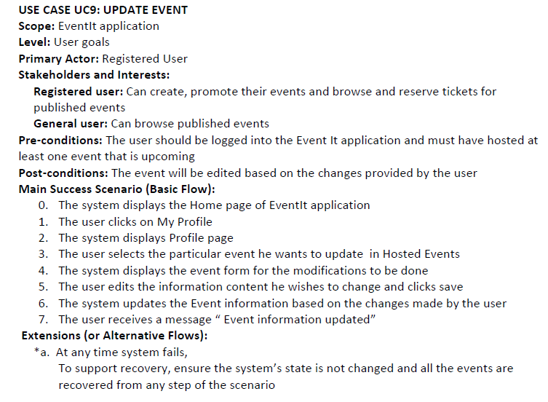
USE CASE UC9: UPDATE EVENT

Slide 11
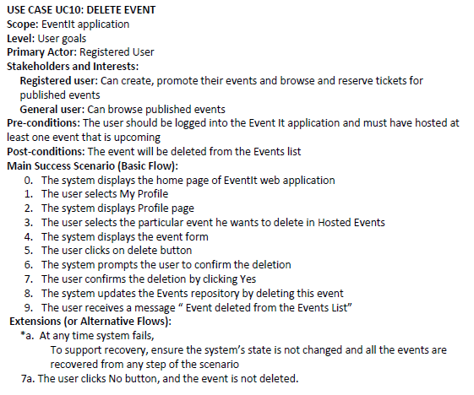
USE CASE UC10: DELETE EVENT

Slide 12
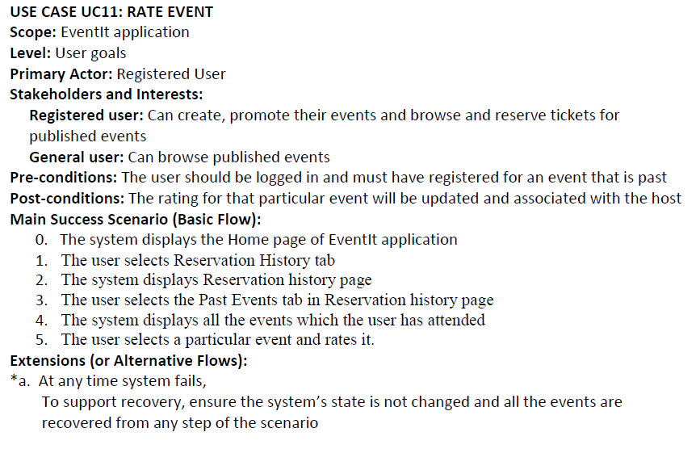
USE CASE UC11: RATE EVENT

Slide 13
SYSTEM SEQUENCE DIAGRAMS

Slide 14
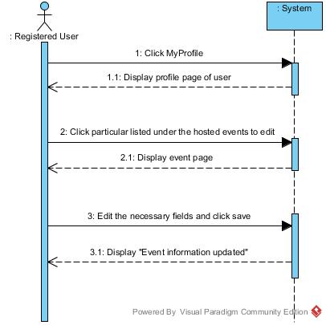
UPDATE EVENT

Slide 15
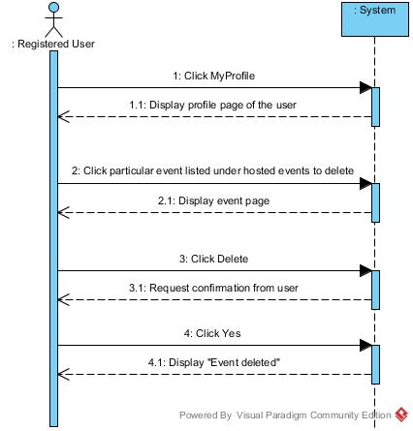
DELETE EVENT

Slide 16
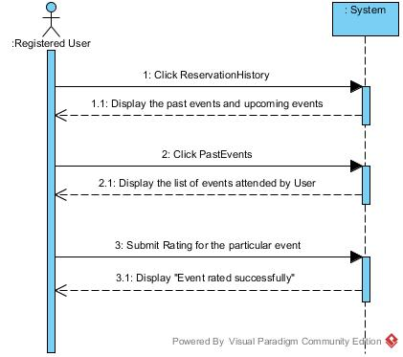
RATE EVENT

Slide 17
OPERATION CONTRACTS

Slide 18
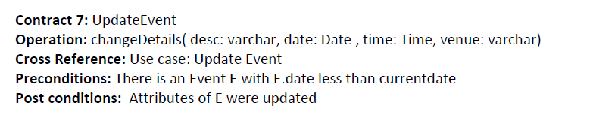
Contract 7: UPDATE EVENT

Slide 19
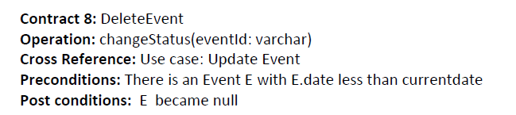
Contract 8: DELETE EVENT

Slide 20
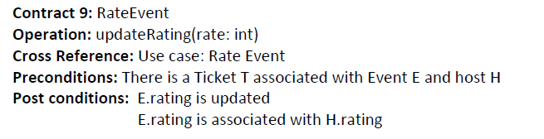
Contract 9: RATE EVENT

Slide 21
DESIGN PATTERNS
GRASP:
Controller
Expert
High Cohesion
Low Coupling
Pure Fabrication
GOF
Singleton
Proxy
Adapter
Observer
Iterator
Following Patterns , if adopted, along with the above mentioned patterns could have made the design more better
Persistence
factory

Slide 22
INTERACTION DIAGRAMS

Slide 23
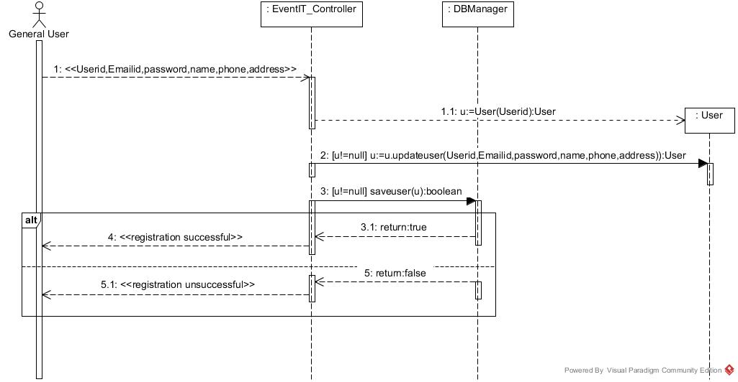
REGISTER

Slide 24
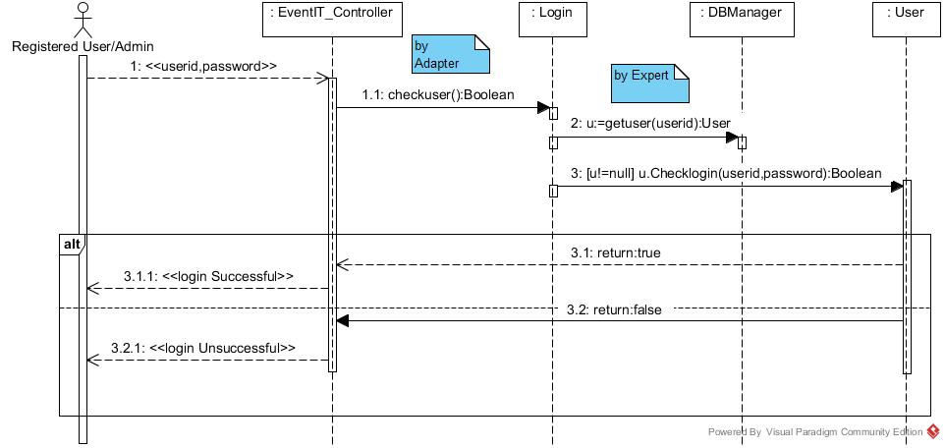
LOGIN

Slide 25
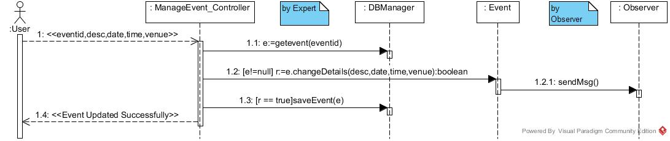
UPDATE EVENT

Slide 26
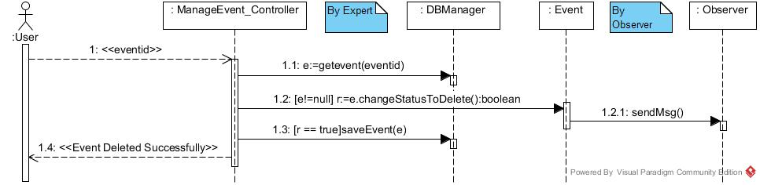
DELETE EVENT

Slide 27
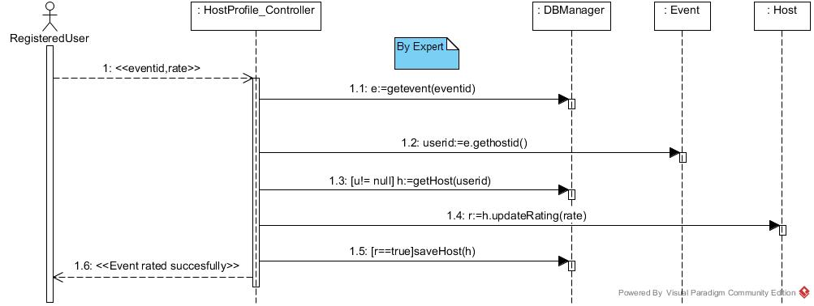
RATE EVENT

Slide 28
CLASS DIAGRAM

Slide 29
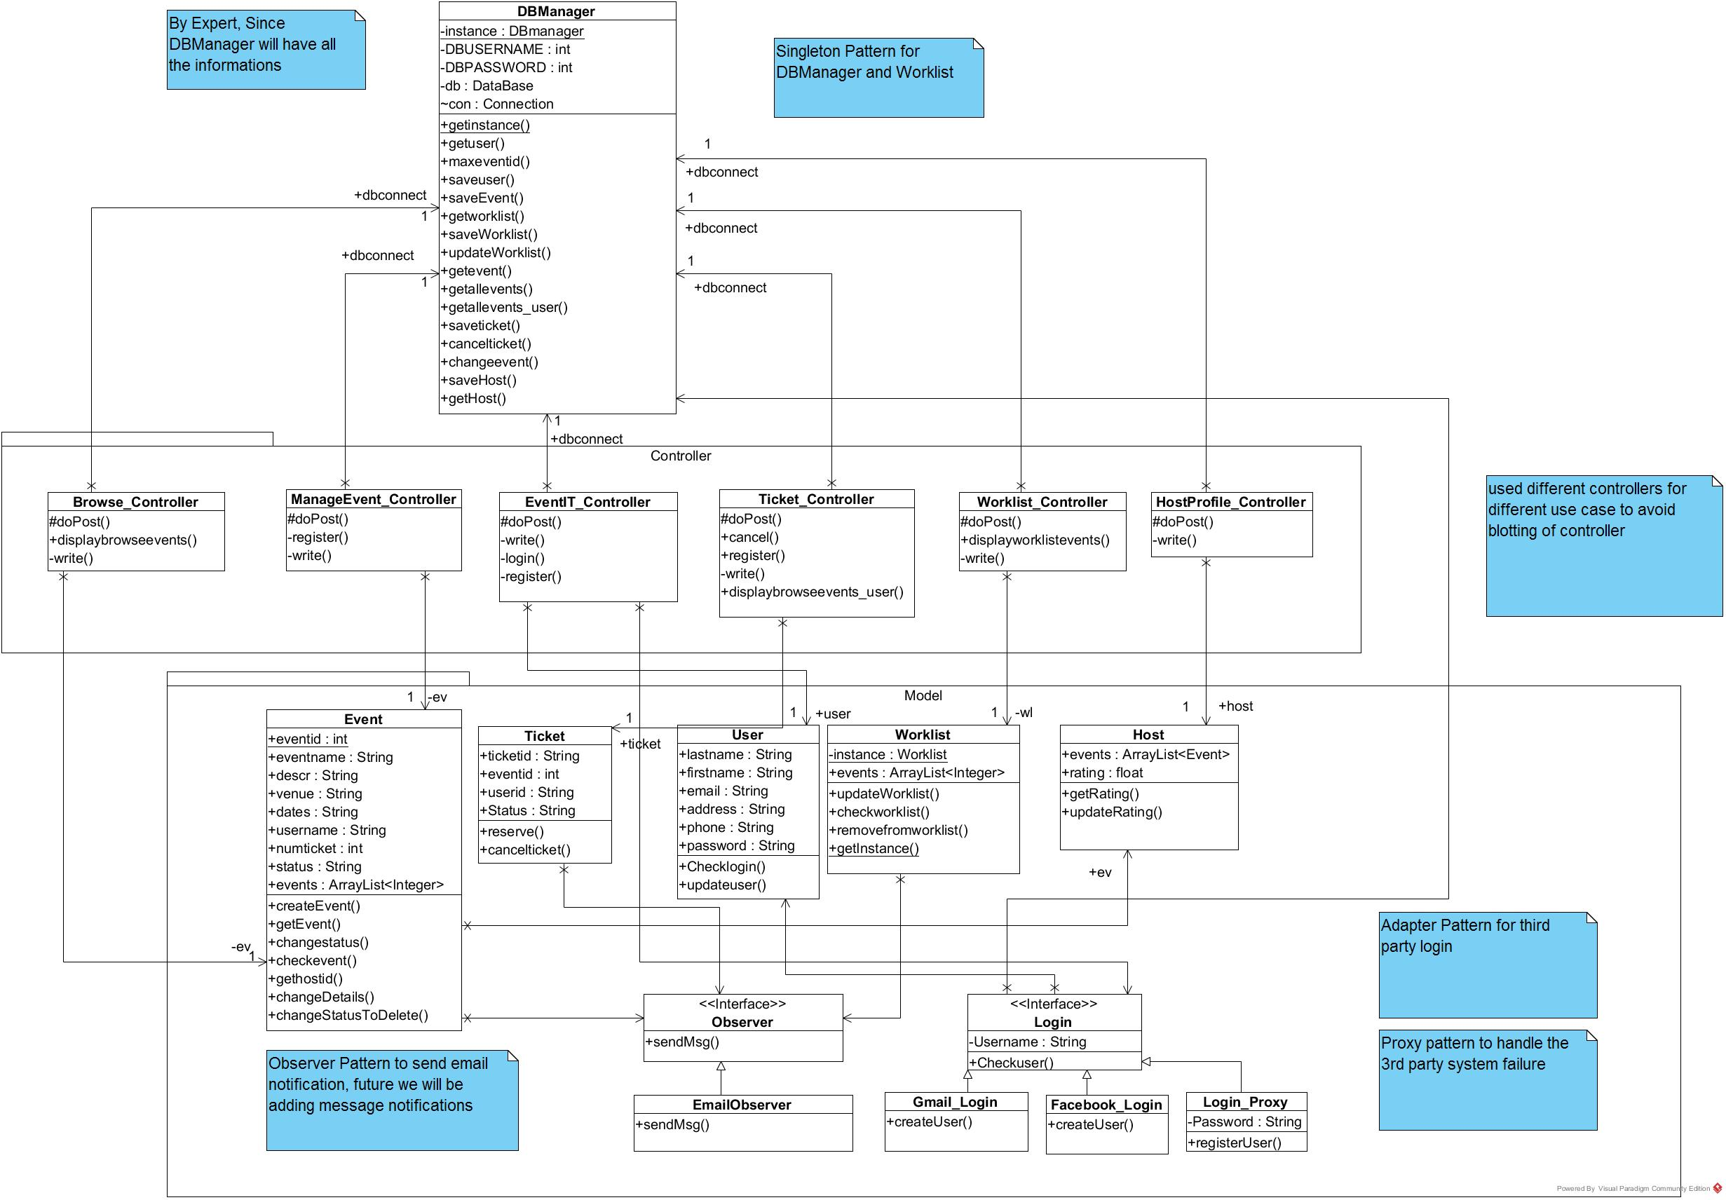

Slide 30
LEARNING FROM THE PROJECT
Using AGILE methodology for developing a product is a better approach than waterfall.
Using Object oriented analysis and design helps you to easily create and maintain the product.
Design patterns from the experience of many experts makes the development of the software product much easier

Slide 31
THANK YOU!
QUESTIONS?

